Slide 1
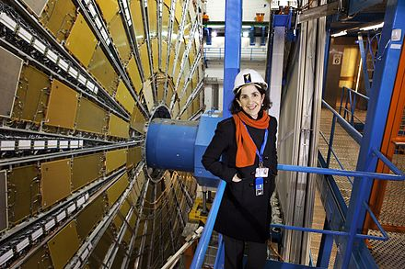
Fabiola Gianotti
Notes:
# Name Fabiola Gianotti # Textbook Knight, Physics for Scientists and Engineers: A Strategic Approach with Modern Physics, 3rd Edition, Chapter 42 # Contributors # Description Fabiola Gianotti (born October 29, 1960) is an Italian particle physicist, currently CERN (European Organization for Nuclear Research) Director-General and the first woman to hold this position. Fabiola Gianotti received a Ph.D. in experimental particle physics from the University of Milan in 1989. Since 1996, following several postdoctoral positions, including a fellowship at CERN, she has been a research physicist in the Physics Department of CERN, the European Organization for Nuclear Research, and since August 2013 an honorary Professor at the University of Edinburgh. She is also a member of the Italian Academy of Sciences (Accademia Nazionale dei Lincei), foreign associate member of the US National Academy of Sciences[4] and foreign associate of the French Academy of Science. Gianotti has worked on several CERN experiments (WA70, UA2 experiment, ALEPH, ATLAS), being involved in detector R&D and construction, software development and data analysis. # Sources https://en.wikipedia.org/wiki/Fabiola_Gianotti # Photo https://upload.wikimedia.org/wikipedia/commons/thumb/e/e8/Portrait_of_Fabiola_Gianotti.jpg/440px-Portrait_of_Fabiola_Gianotti.jpg

